Slide 1


Healing Through Chemistry
Self-Repairing Electrocatalysis for Fluctuation Resilience
Lin Zhuocheng

Slide 2
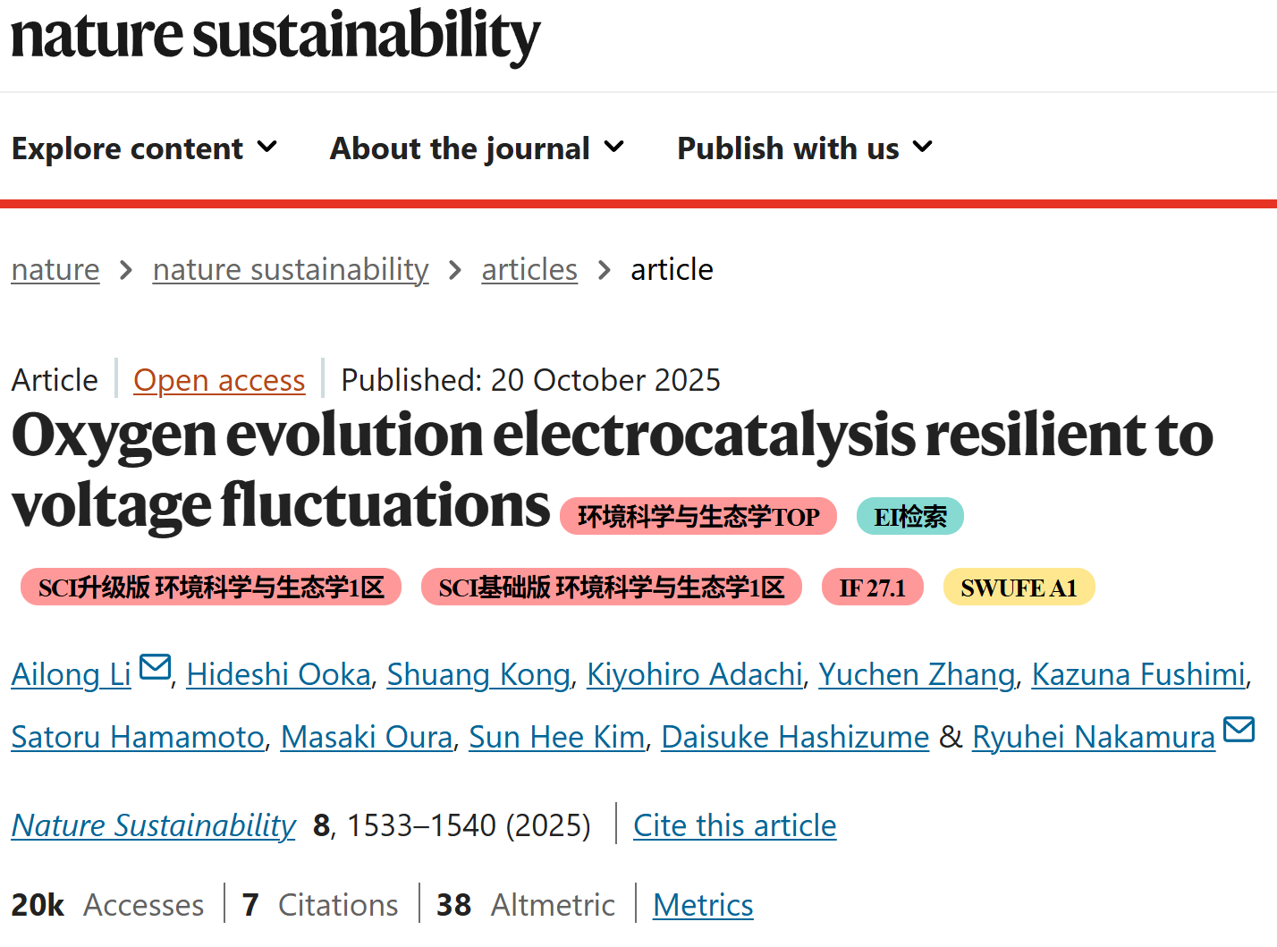

Slide 3
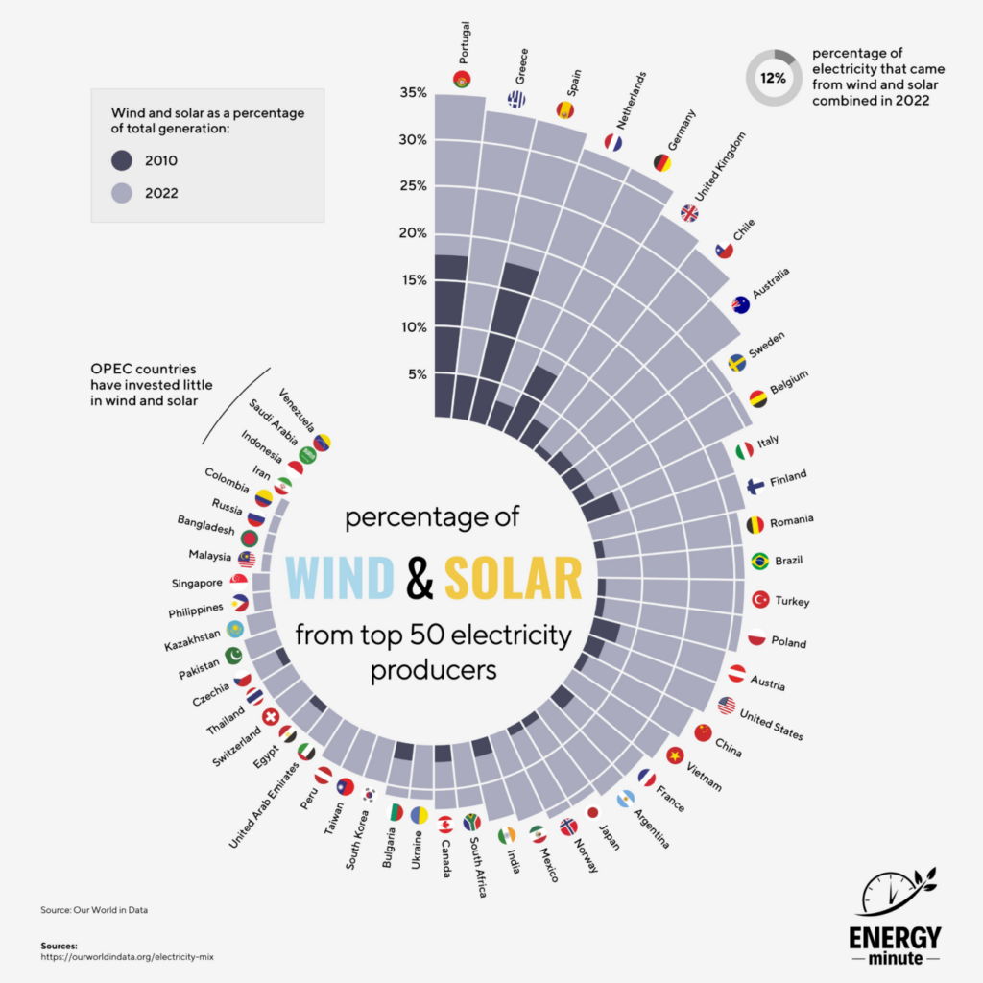
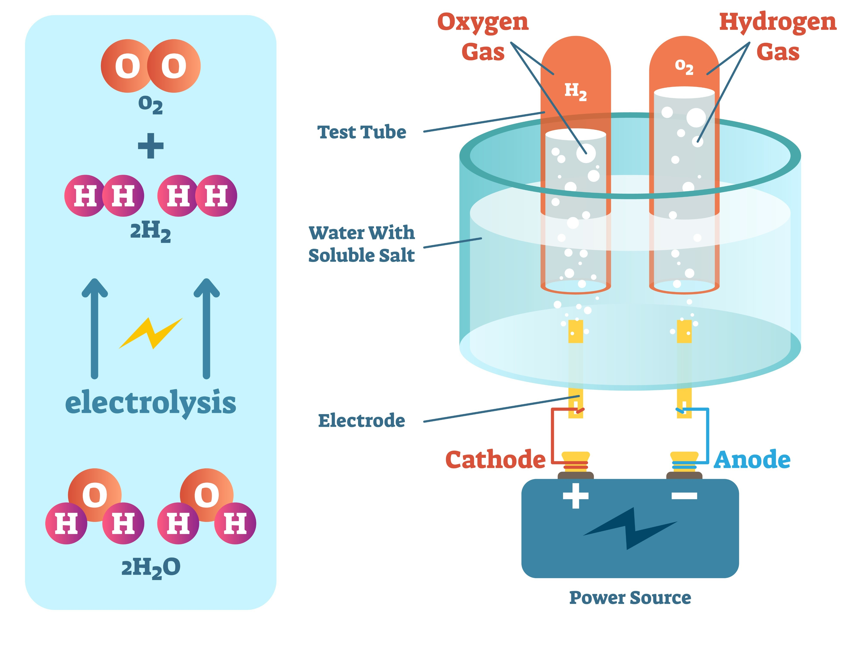

WATER ELECTROLISIS
2 H₂O(l) → 2 H₂(g) + O₂(g)

Slide 4
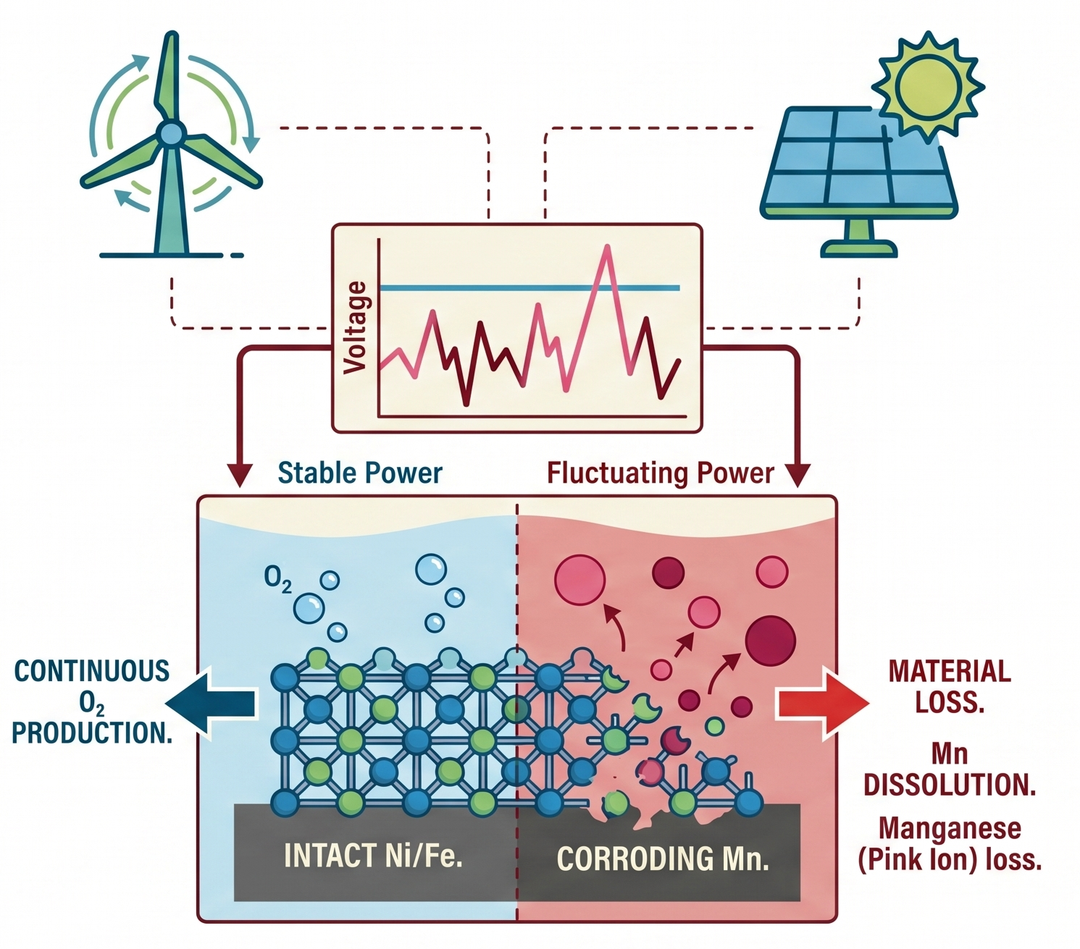
THE CHALLENGE OF NATURE
Intermittent Sources: Solar and wind fluctuate on timescales of seconds.
Catalyst Fragility: 3d-block metals degrade under small voltage variations.
Sustainable Synthesis: Harnessing intermittency is key for green hydrogen.
H₂

Slide 5




THE "OFF-CYCLE" TRAP
Standard Operation
Mn⁷⁺
Voltage < 1.75V vs RHE
Stable sequential oxidation: Mn²⁺ → Mn³⁺ → Mn⁴⁺
Corrosion Phase
Voltage > 1.8V vs RHE
Irreversible Dissolution: Manganese turns to Mn⁷⁺ (Pink)

Slide 6






THE GUYARD REACTION 4 Mn²⁺ + Mn⁷⁺ ­→ 5 Mn³⁺
Additive
Phosphate ions added to
pH 2 electrolyte.
Mn⁷⁺
Interaction
Dissolved Mn⁷⁺ reacts with Mn²⁺ OER intermediates.
Redeposition
Mn³⁺ forms and oxidizes back to bulk oxide.

Slide 7
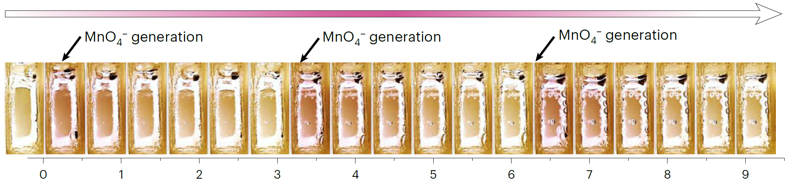
RIGOROUS TESTING SETUP
Environment: Sulfuric Acid (pH 2)
Additive: 1.0 M Phosphate
Fluctuation Simulation:
High pulse: 3.00 V (8 min)
Base potential: 1.68 V (3 h)

Slide 8
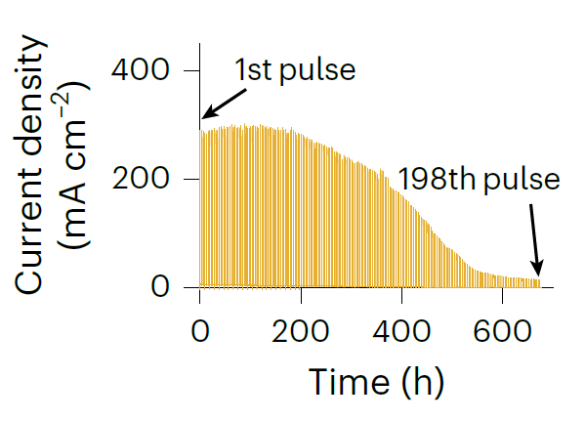
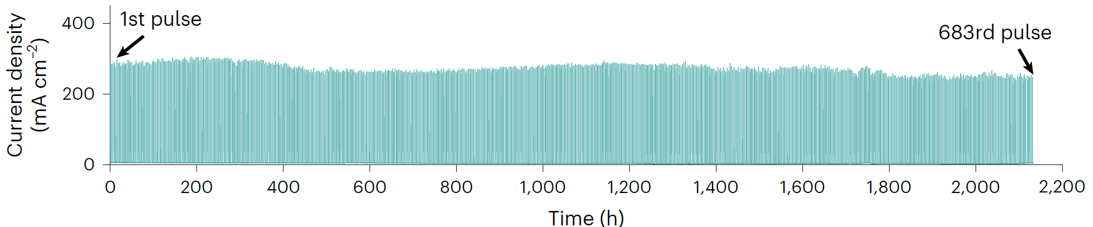
COMPARATIVE ANALYSIS
Sulfuric Acid
+ Phosphoric Acid
UNPRECEDENTED LONGEVITY

Slide 9
COMPARATIVE ANALYSIS
Sulfuric Acid
+ Phosphoric Acid
UNPRECEDENTED LONGEVITY

Slide 10
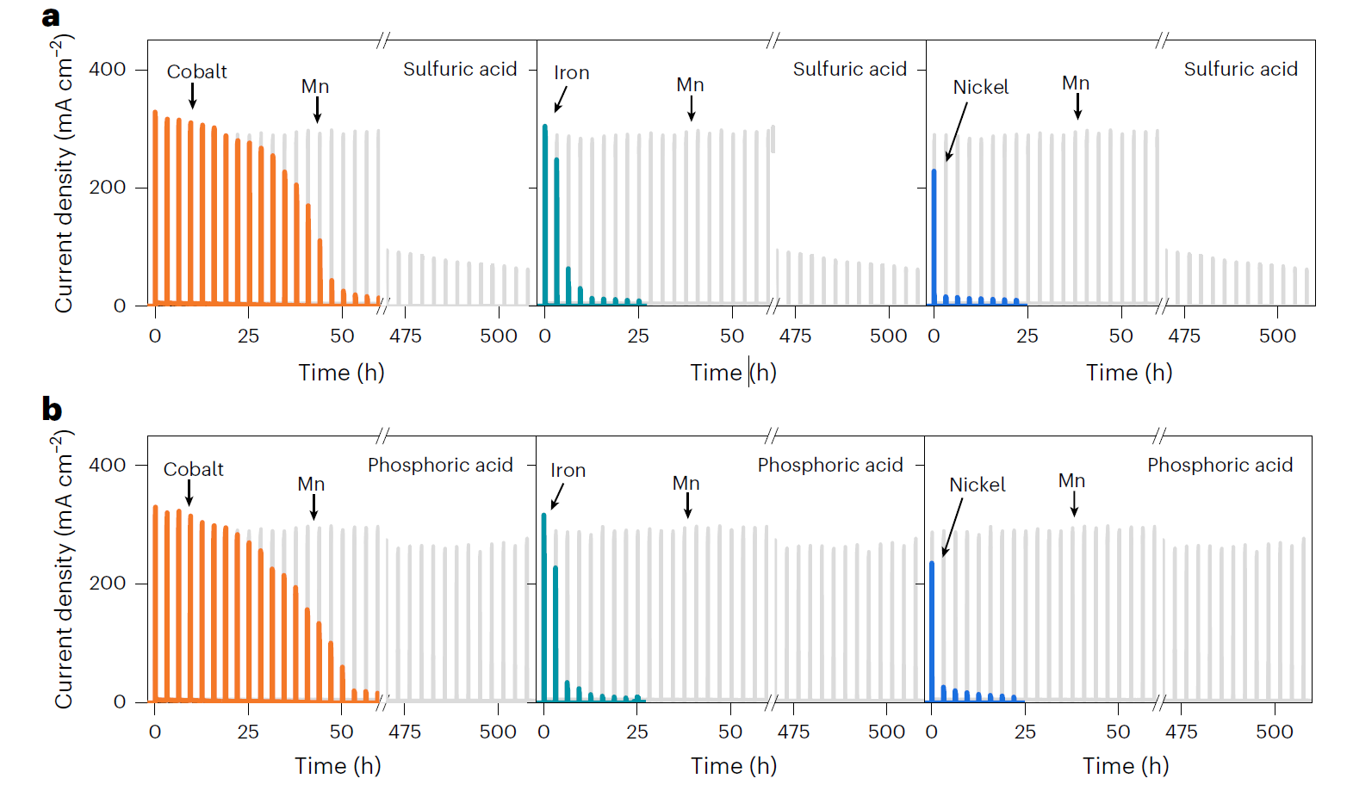
COMPARATIVE ANALYSIS
UNPRECEDENTED LONGEVITY

Slide 11

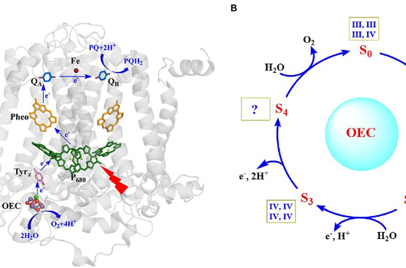
NATURE'S WISDOM
Why did nature choose Manganese for photosynthesis?
Resilience > Activity: Survival under fluctuating light.
Innate Repair: Constant supply of Mn²⁺ allows rebuilding of the active site.

Slide 12
IMPACT SUMMARY
Redefining Pathway Design
Incorporating self-healing mechanisms allows us to move beyond high-purity, steady-state systems.
15x
Higher Stability
Direct connection to intermittent wind/solar becomes viable without massive battery buffering.

Slide 13
FUTURE OUTLOOK
PEM Electrolysers: Modifying the microenvironment for industrial scale.
Membrane Tuning: Integrating phosphate groups into Nafion membranes.
Sustainability: Reducing reliance on rare Iridium-based catalysts.

Slide 14
Thank you for your attention.
Questions?
Lin Zhuocheng

Slide 15




IMAGE SOURCES
https://energynow.com/wp-content/uploads/The-Growth-of-Wind-and-Solar-ENERGYminute-1024x1024.png
Source: energynow.com
https://media.istockphoto.com/id/615395438/photo/chemical-beaker-with-permanganate-dissolved-in-water.jpg?s=612x612&w=0&k=20&c=7p1TXbo3ZHy8nLkVBT2qus2sz_B_7GZFGQAqlxhPTbE=
Source: www.istockphoto.com
https://www.priyamstudycentre.com/wp-content/uploads/2023/12/Water-Electrolysis-process-definition-and-applications-to-produce-hydrogen-and-oxygen.png
Source: www.priyamstudycentre.com
https://images-provider.frontiersin.org/api/ipx/w=1200&f=png/https://www.frontiersin.org/files/Articles/929532/fpls-13-929532-HTML/image_m/fpls-13-929532-g001.jpg
Source: www.frontiersin.org

